Slide 1
Winlink Introductions

Slide 2
Winlink Is
Communications system for License Hams
Able to send and receive email over radio
Particularly useful in Emergencies
Users can use various methods
  Telnet
  UHF/VHF, HF

Slide 3
Installation
Go to downloads.winlink.org
Perform a regular install on your system
Obtain winlink account email address
Fill out Setup Screen
  Call sign
  Password
  Locator number, etc

Slide 4
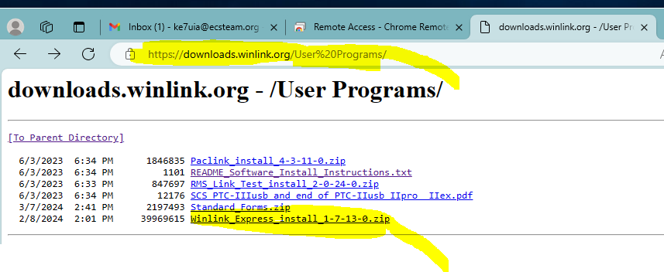
Download.winlink.com

Slide 5
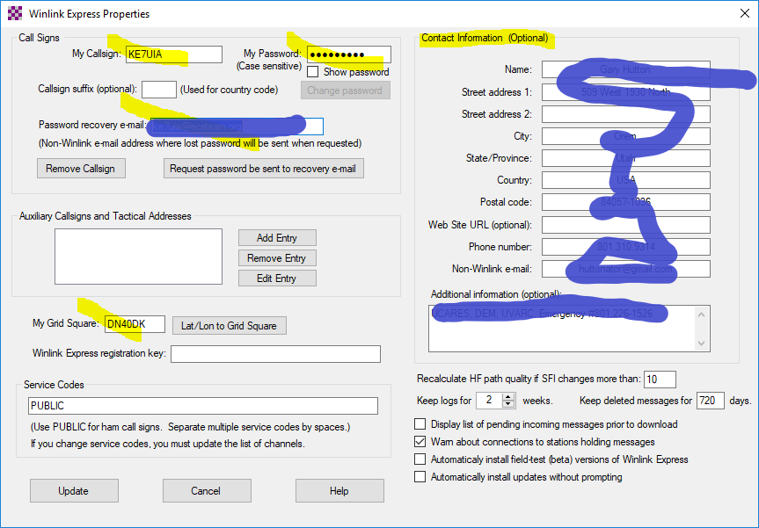
Setup screen

Slide 6
Obtain email address
Read instructions on winlink.org
Youtube.com is your friend
Your winlink email address is just your call sign
Example = ie. ke7uia

Slide 7
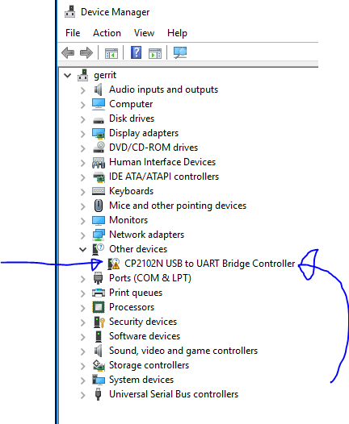
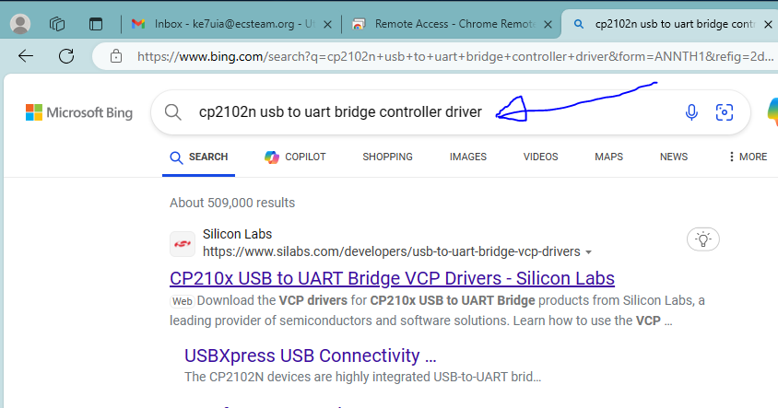
Install Drivers

Slide 8
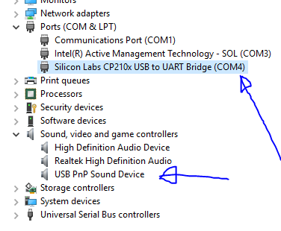
Com Ports

Slide 9
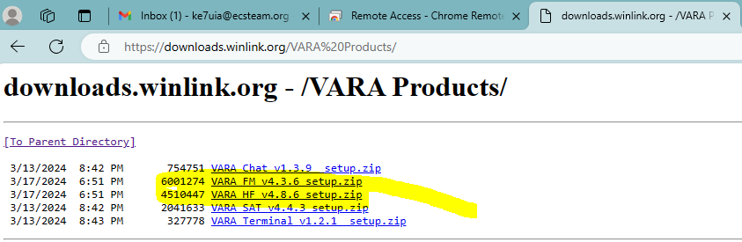
Download VARA FM

Slide 10
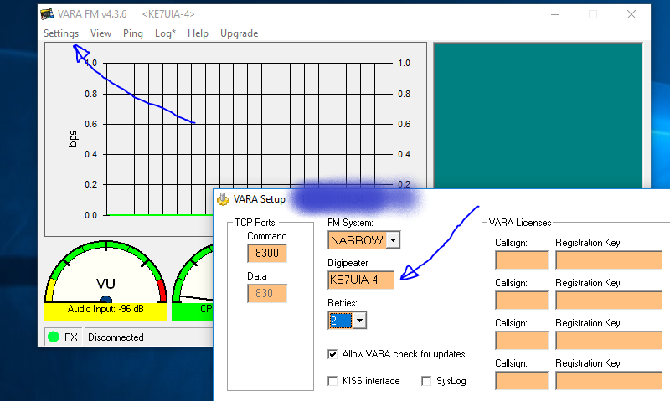
VARA Settings

Slide 11
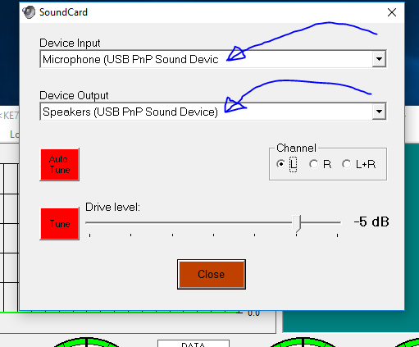
VARA – Sound Card

Slide 12
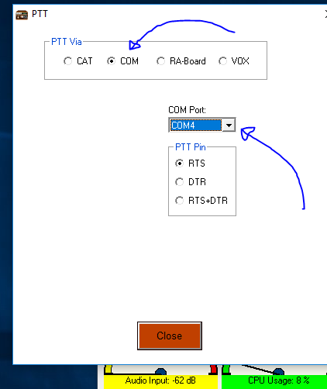
VARA – PTT Port

Slide 13
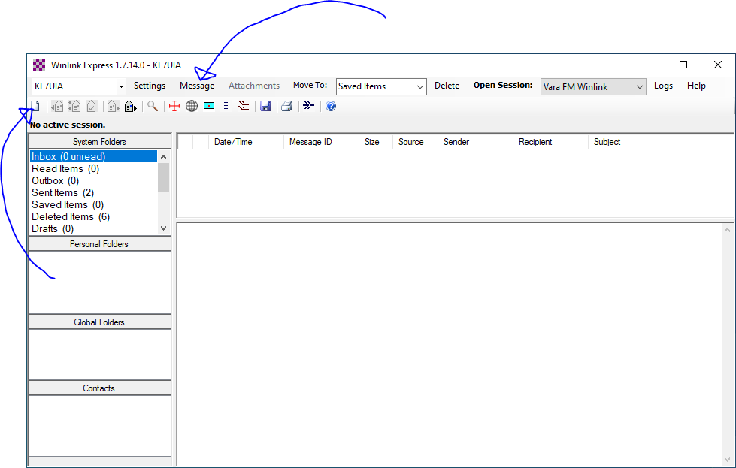
Create Message

Slide 14
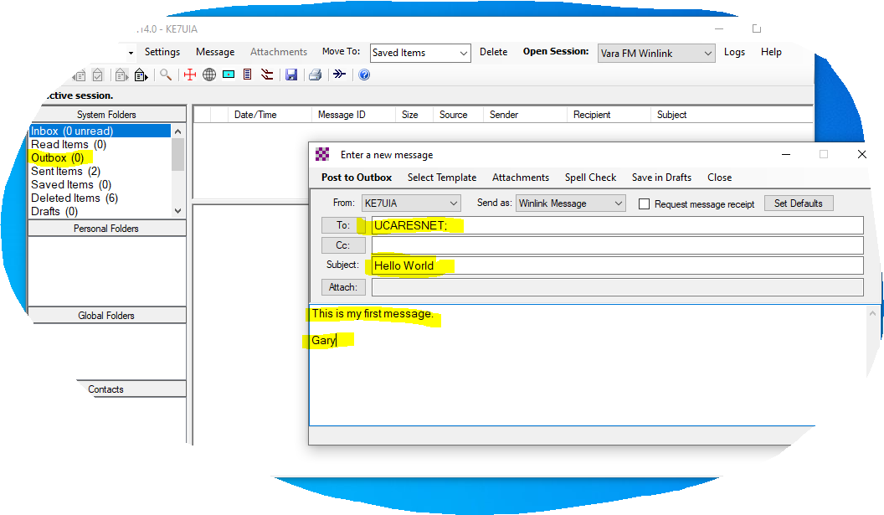
Create Message 2

Slide 15
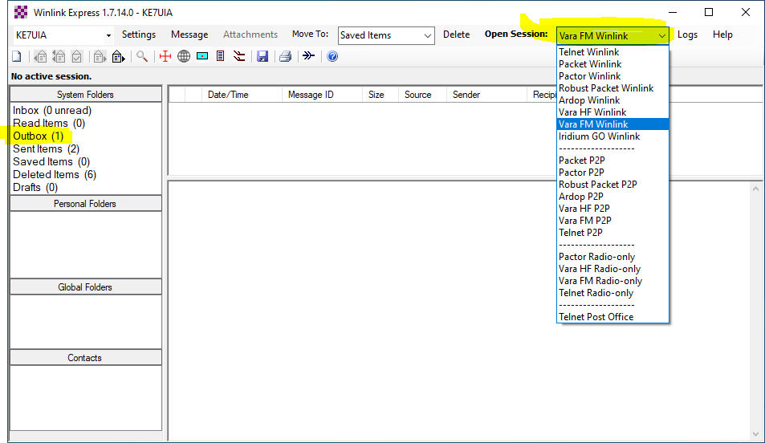
Select Session Type

Slide 16
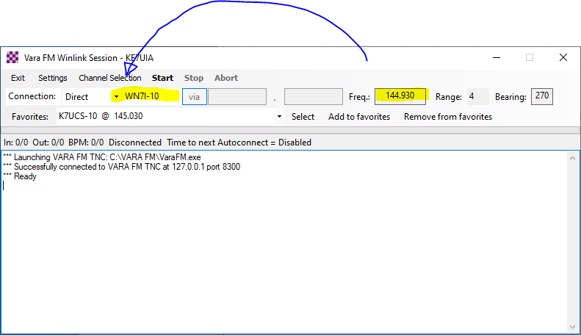
Select Channel

Slide 17
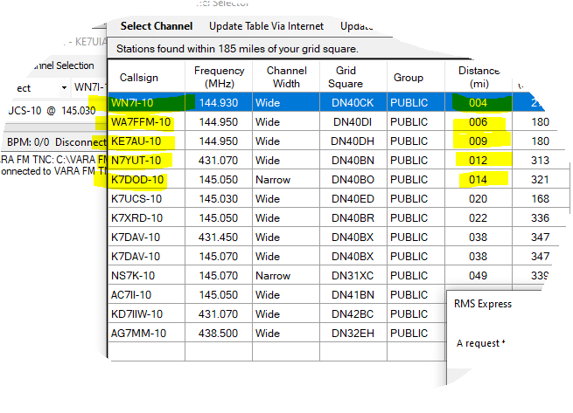
Select Channel 2

Slide 18
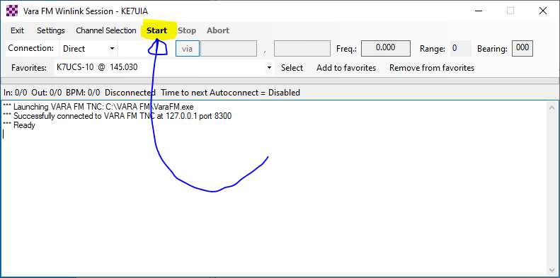
Press Start

